Slide 1
Billionaire Bootcamp

Slide 2



OUTLINE
01
03
05
Introduction
Omar Emara
Startup country
Amir Mohamed
Conclusion
Become a CEO and start your own startup
228248
How to choose the right country to start your own business?
224030
Concluding and Q&A.
02
04
Omar Emara
Omar Emara &
Amir Mohamed
Amir Mohammed
228248
Unique Product
Net worth
224030
How to make a unique product?
How to use net worth to generate more money?

Slide 3
INTRODUCTION
CEO?
OMAR EMARA
Omar Emara and Amir Mohamed desire to become self-made billionaires but they don’t know how to start their journey.
The best choice for them is to use Data Science to study other billionaires to reach their dreams.
After studying billionaires, they discovered that all billionaire are their own CEOs, so they decided to follow their footsteps.
The first step to become a self-made billionaire is to create your startup and become your own CEO.
CEO
CEO
AMIR MOHAMED

Slide 4
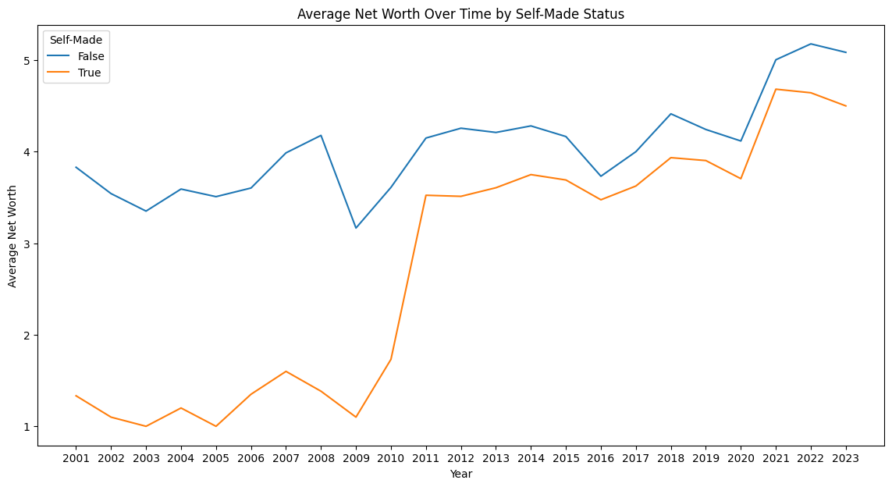
INTRODUCTION
The Self-Made Billionaire Status: A Data-Driven Insight
Self-Made Billionaires:
Generally increasing over time with fluctuations.
Upward trajectory signifies potential for wealth accumulation.
Non-Self-Made Billionaires:
Displays fluctuations but with less volatility compared to self-made counterparts.
Moving upward, though at a steadier pace.
Key Insights:
Self-Made Success: Data highlights the viability of self-made billionaire journeys proving to Omar and Amir that they can shine among all billionaires.
Stability vs. Growth: Non-self-made billionaires exhibit steadier trajectories, while self-made counterparts demonstrate potential for significant wealth escalation, proving to Amir and Omar that they can even pass non-self-made Billionaires

Slide 5

UNIQUE PRODUCT
The Startup Purpose
After the CEOs proved to themselves that the journey of becoming self-made billionaires is possible, they carried on the next step.
In order to have a successful business, it has to sell something.
The CEOs plan to offer a unique product to attract all the eyes around the world.
However, that comes with a lot of questions:
What is the purpose of the product?
What is the audience of the product?
What makes this product special?

Slide 6
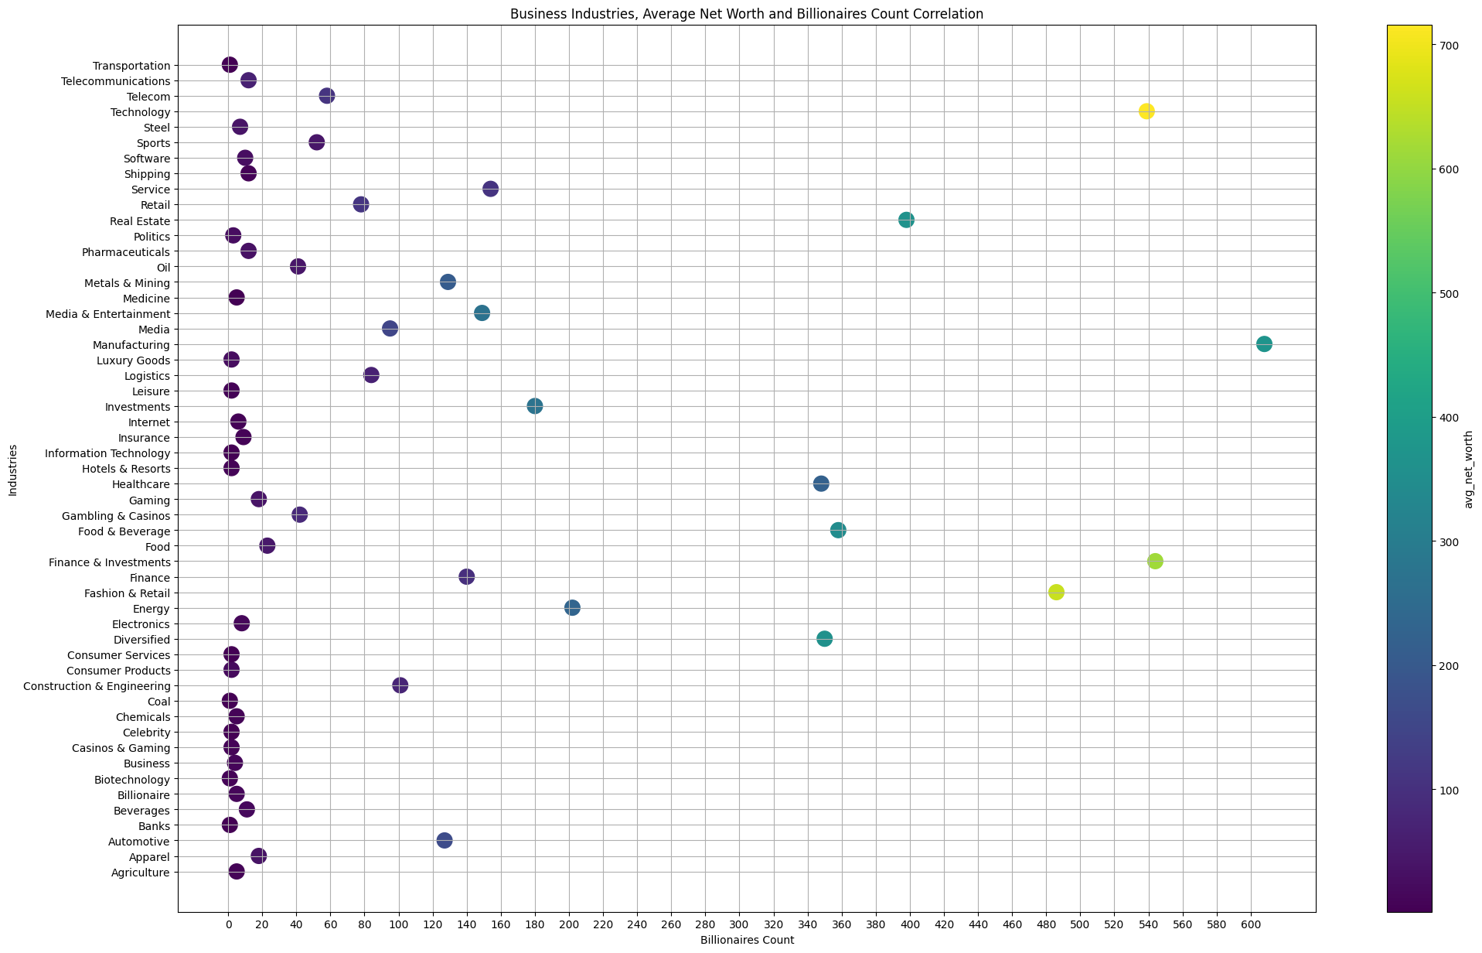
UNIQUE PRODUCT
The Most Guaranteed Industries to Generate Profit
To determine the purpose of the product, an industry or an audience had to be chosen.
Based on the scatter plot graph, the top industries are:
Technology: High billionaire count and high average net worth
Finance & Investments: Also shows a significant number of billionaires with substantial net worth.
Fashion & Retail: Notable for its number of billionaires and their wealth.
The industries that are more likely to have less competition and generate profit, judging by the moderate number of billionaires and high net worth, are:
Food & Beverage: Moderate billionaire count and moderate average net worth.
Real Estate: Moderate billionaire count and moderate average net worth.

Slide 7
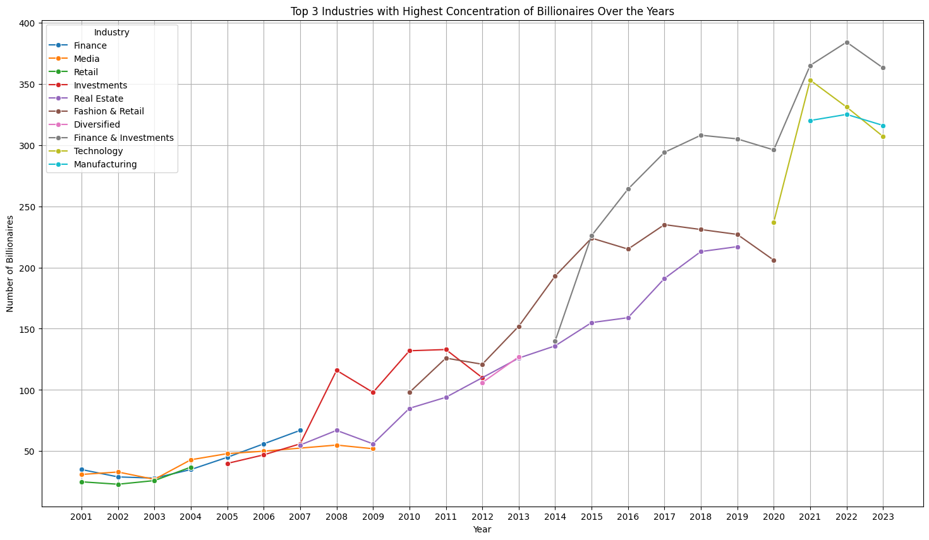
UNIQUE PRODUCT
More Data insights
The data shows top 3 industries with the highest concentration of billionaires, and how does this distribution change over the years?
Trends in Industries:
Industries like Finance, Fashion & Retail, and Real Estate seem to be the top 3 industries for the longest time.
In the recent 3 years, Technology, Finance & Investments, and Manufacturing occupy the top 3 industries with billionaire contributions.
Media and Finance were the dominating industries in terms of billionaire's concentration up until 2009.

Slide 8

UNIQUE PRODUCT
Uniqueness
The CEOs decided that the purpose of their product would be the one thing that makes it special
The purpose of the product is bridging a couple of industries together through the product.
Based on previous insights, the CEO chose the following industries to bridge:
Technology: High billionaire count and high average net worth
Finance & Investments: Also has a significant number of billionaires with substantial net worth.
Real Estate: Moderate billionaire count and moderate average net worth, proving a chance to enter the market.
The product was chosen to be: A software that manages the finance and investments of real estate companies

Slide 9
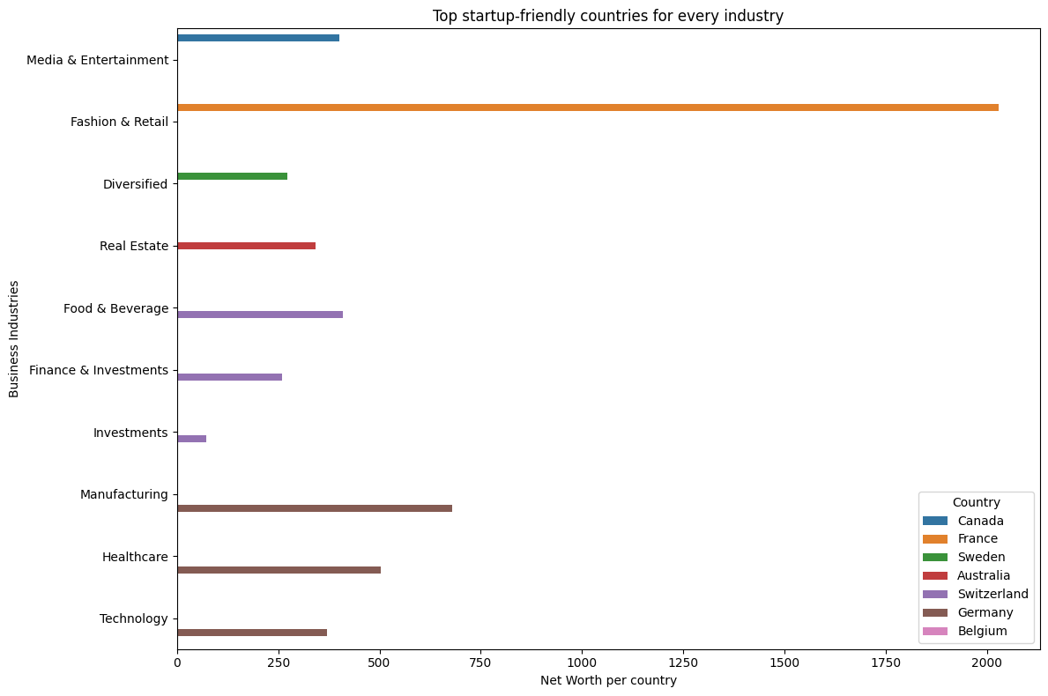
STARTUP COUNTRY
Start-up friendly countries
The CEOs decided to choose the country of their startup based on their ranking as startup friendly countries.
Based on the data provided in the graph, the most startup friendly countries are:
Germany: Has the highest net-worth of its industries and highest startup friendly score in 3 out of the top industries including technology
Switzerland: Has the highest net-worth of its industries and highest startup friendly score in 3 out of the top industries including finance
France: Has the highest net-worth in fashion industry as well as the highest net worth for a country on the graph for highest startup friendly

Slide 10
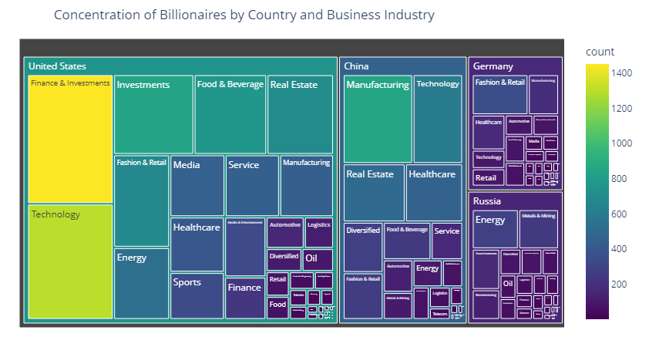
STARTUP COUNTRY
Concentration of Industries Across Countries
To assist their decision, the CEOs also searched for the most countries concentrated with billionaires so that finding investors would be easier.
Based on the graph, the most concentrated countries are:
United States: Technology and Finance & Investments are the dominant business categories among billionaires in the United States.
China: Technology and Manufacturing are the primary business categories among billionaires in China.
Germany: Healthcare, Manufacturing, Technology, and Diversified sectors have a significant presence among billionaires in Germany.

Slide 11
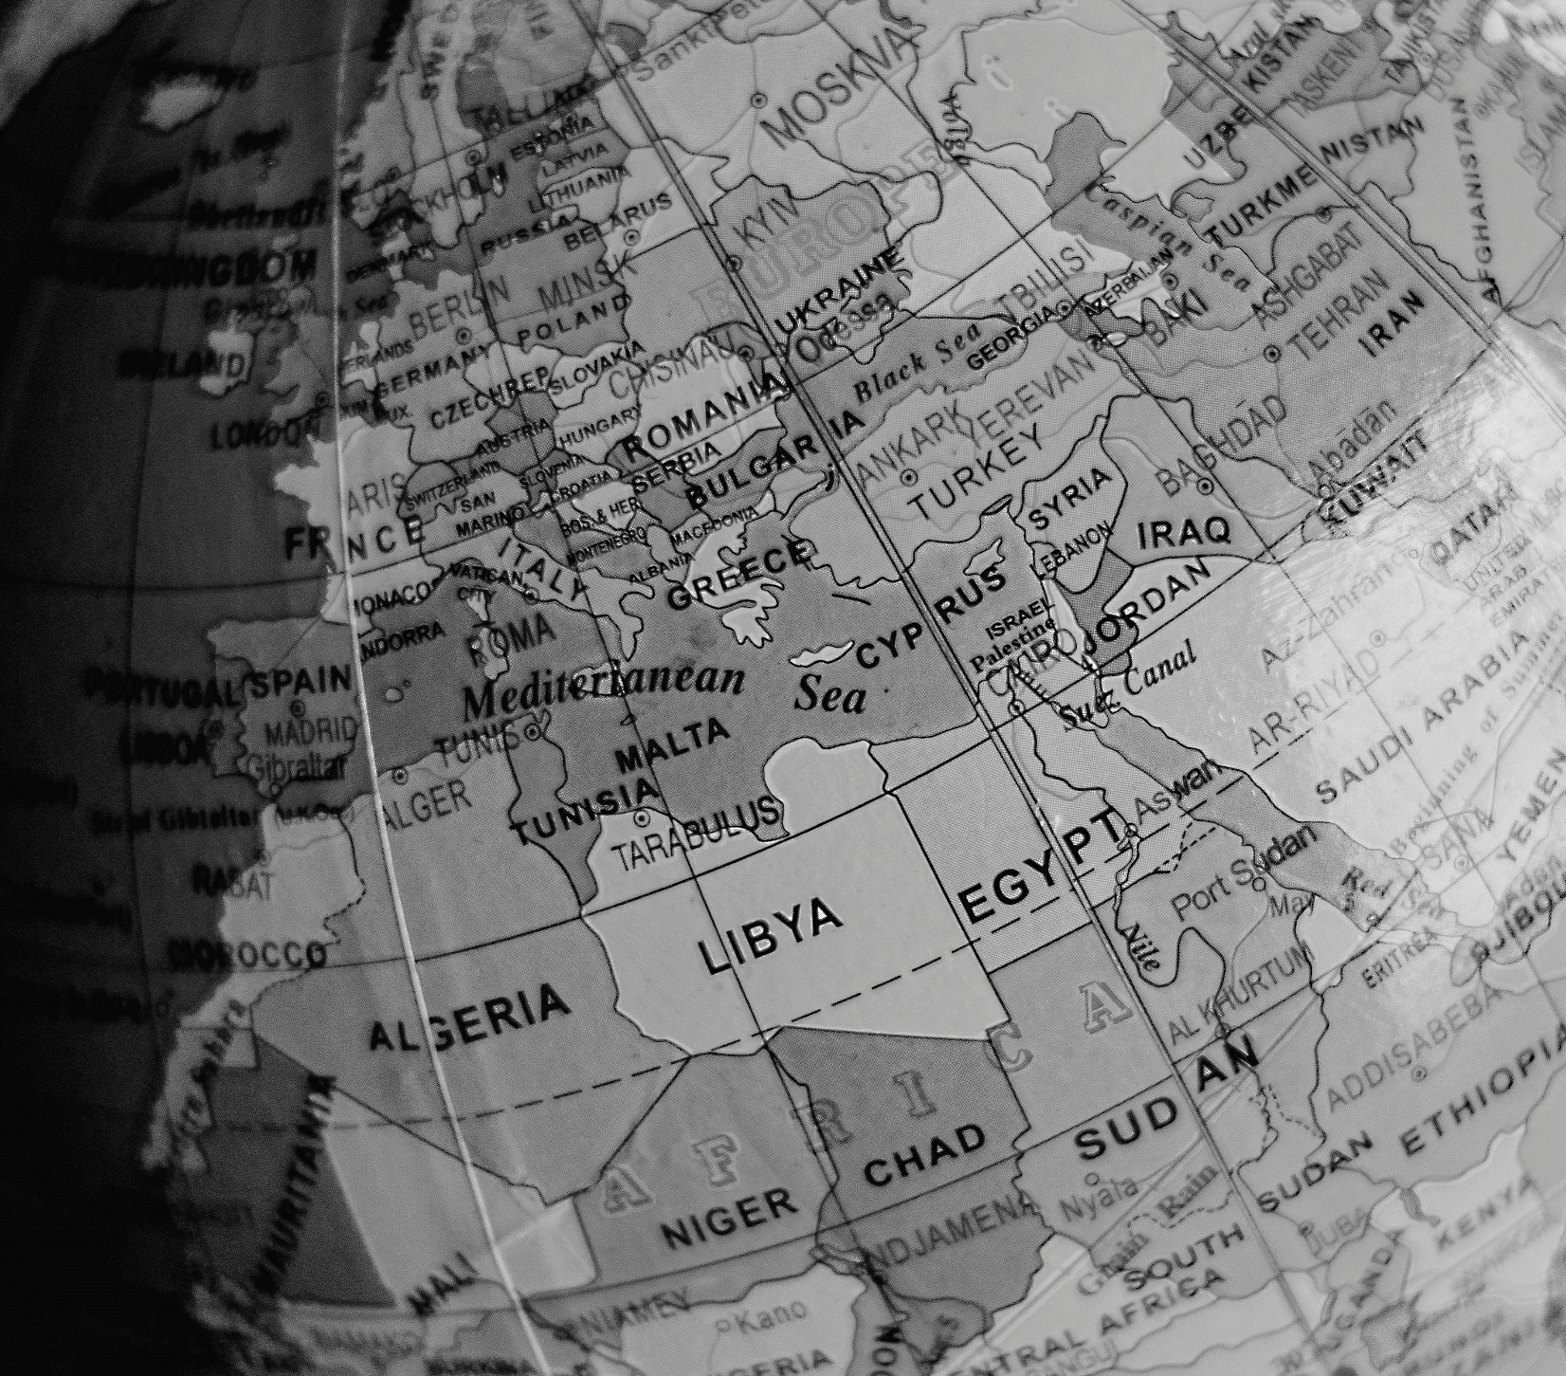
STARTUP COUNTRY
Final Choice
Based on the previous insights, the CEOs finally choose Germany as the country to host their startup
The reasons behind choosing Germany are:
The country is one of the highest-ranking startup friendly countries
The country also has a high concentration number of billionaires across all the industries the CEOs chose
The high concentration of billionaires and startups proves that Germany is also a good market to sell the product

Slide 12
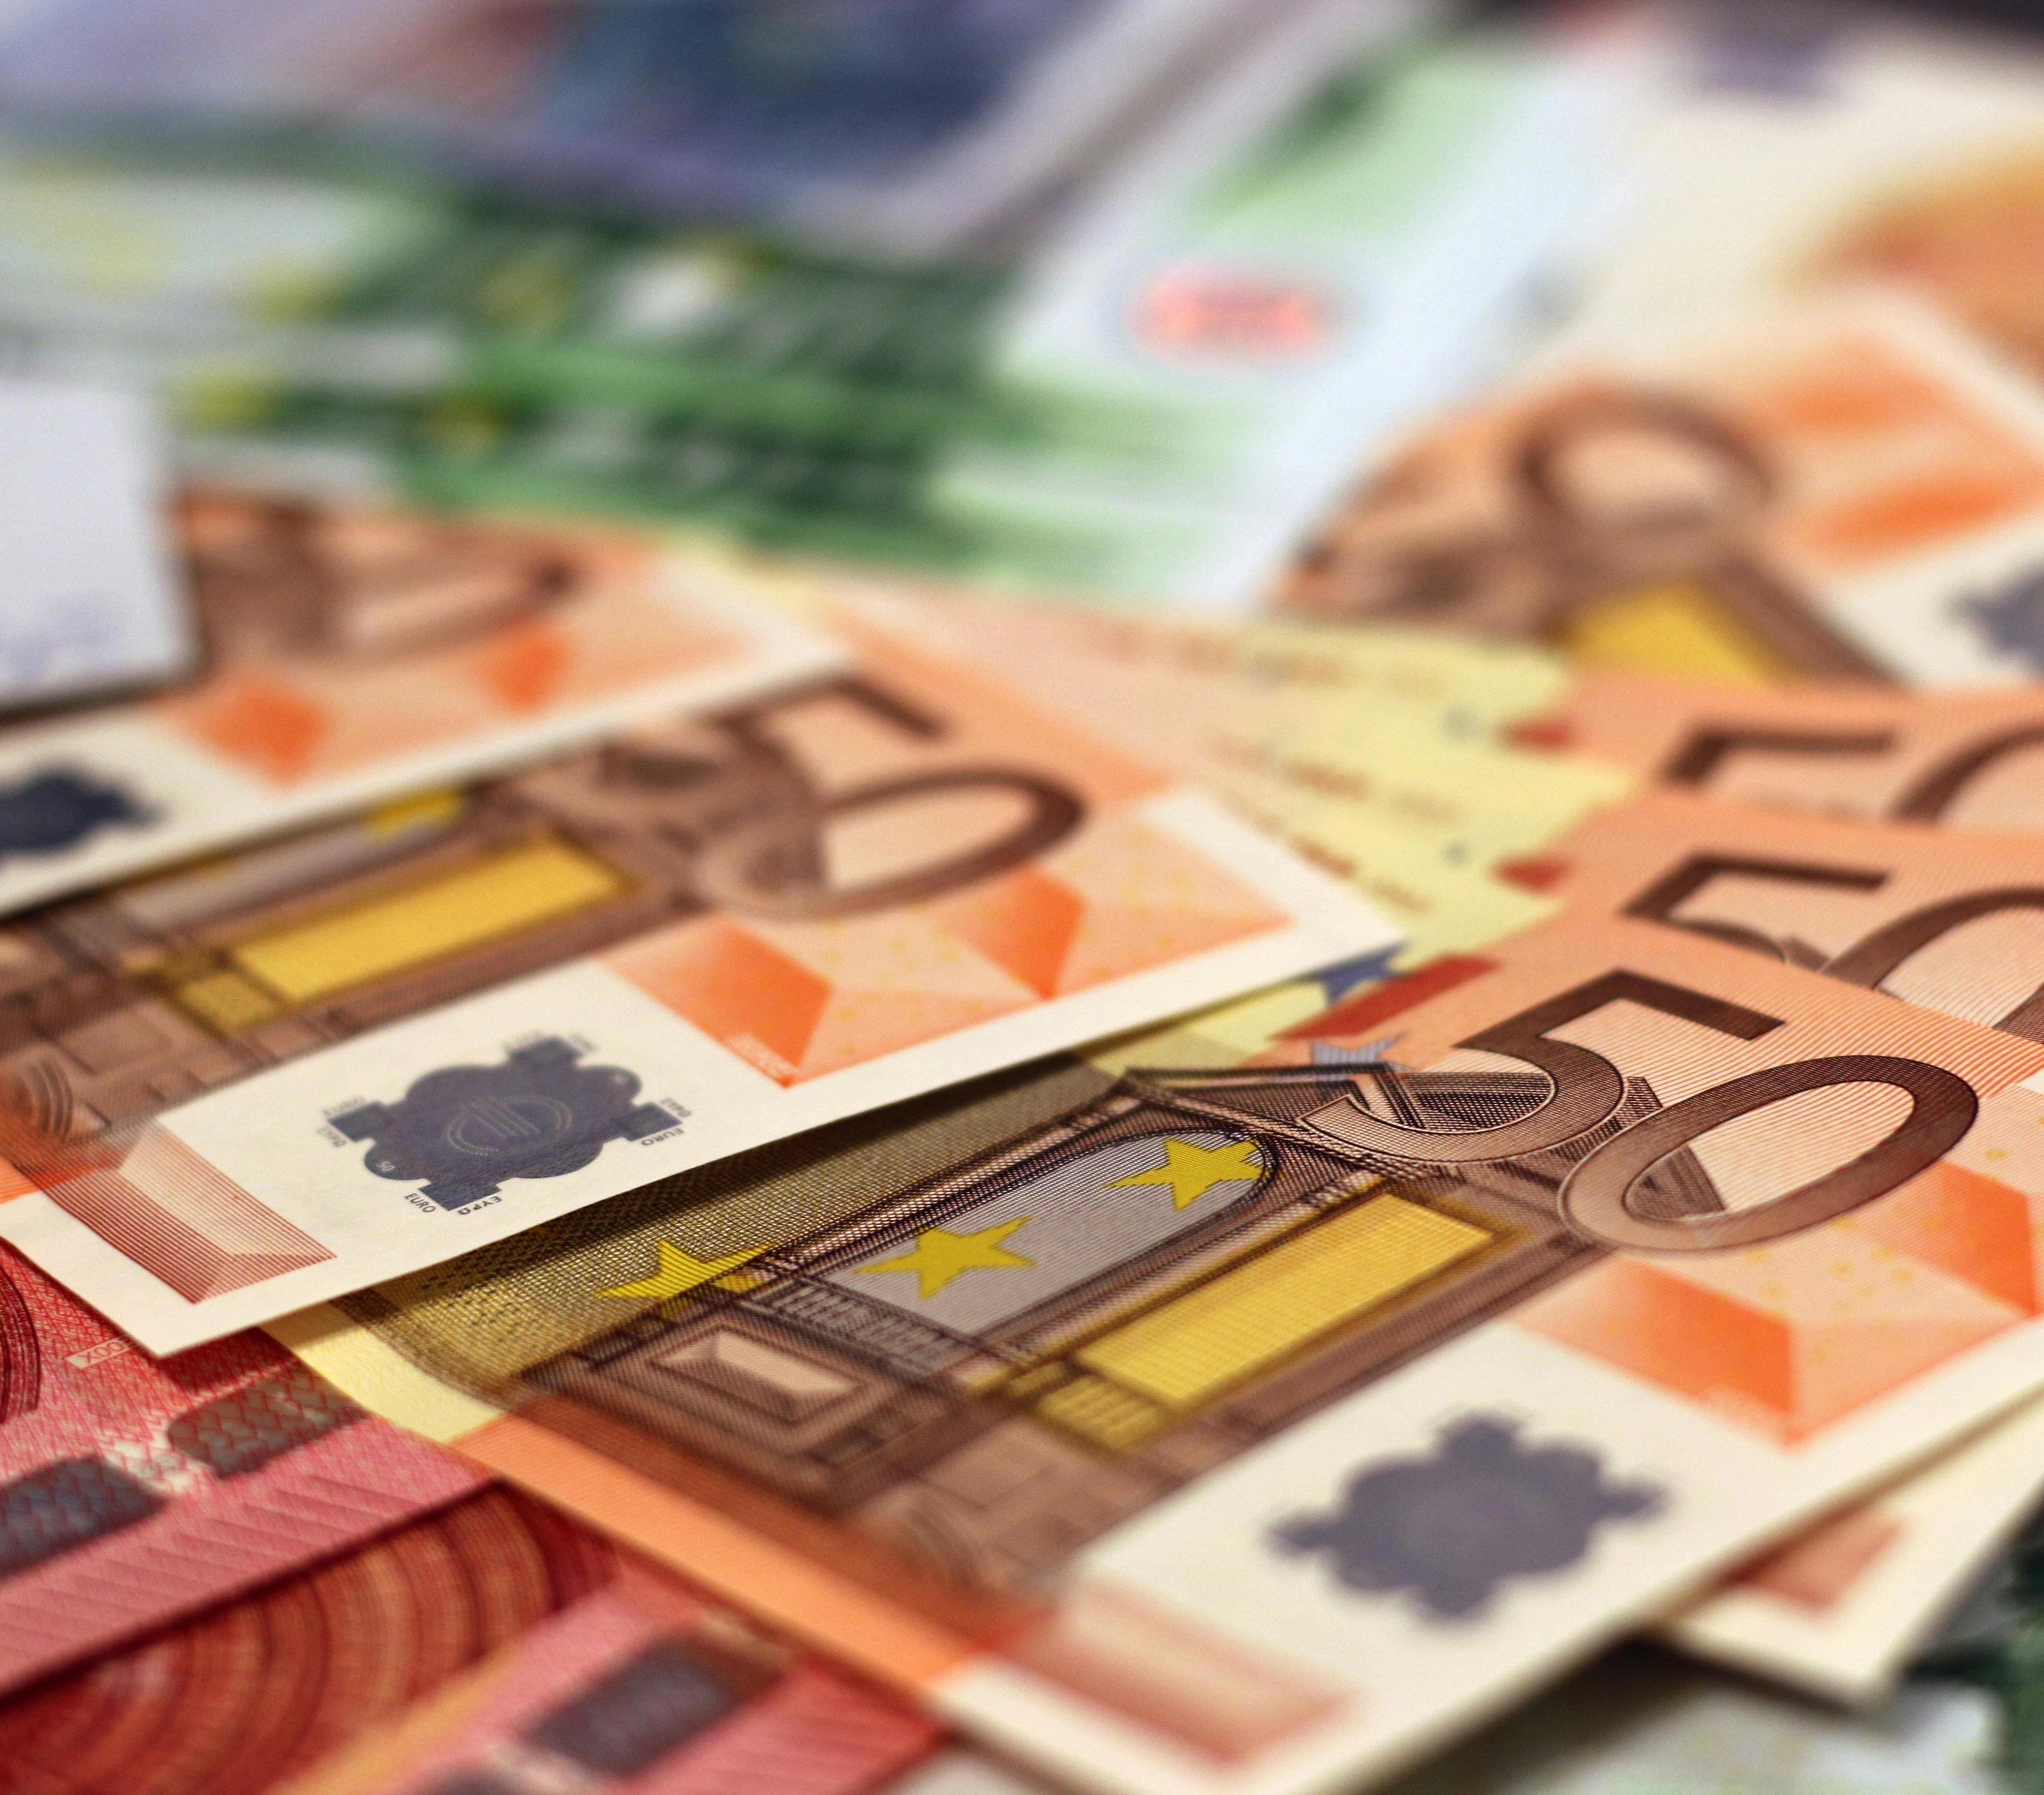
NET WORTH
Dealing With Net Worth
After establishing the startup and generating profit, the CEOs would have to deal with the profit they received from their business:
First thing to do is improving the startup in all possible aspects because it will be the one thing that will provide more profit
The second thing to do is investing in other projects so that the net worth grows, and the CEOs dream comes closer

Slide 13
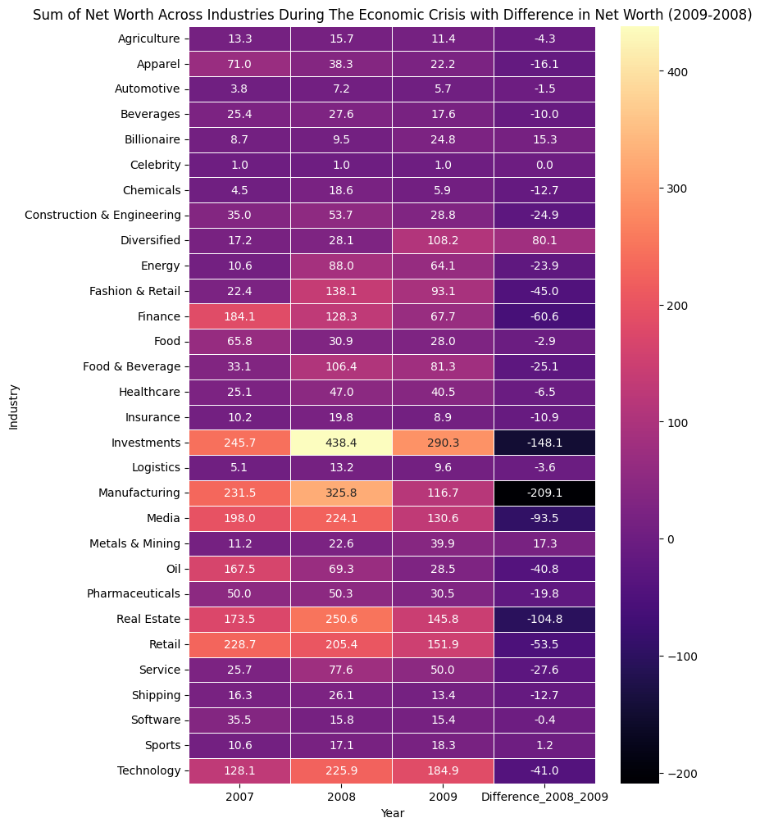
NET WORTH
Industries Survived 2008 Crisis
Based on the data, the following industries were the best:
Metals & Mining: Also showed growth that could indicate resilience due to constant demand for raw materials.
Sports: Showed remarkable stability during the 2008 economic crisis.
Healthcare: Despite a slight decrease from 25.1 to 40.5, the -6.5 difference indicates relative stability, likely due to the essential nature of healthcare services.

Slide 14
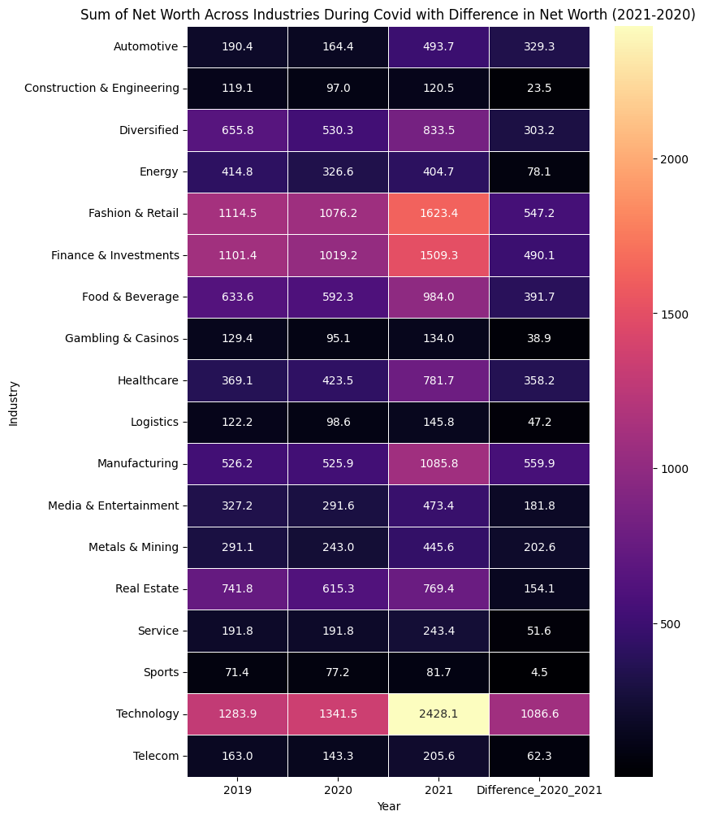
NET WORTH
Industries Survived 2020 Covid
However, the industries during the Covid period were: Technology: has emerged as the safest industry, with substantial growth from 2020 to 2021, indicating its resilience and potential for investment.
Fashion & Retail and Finance & Investments: also experienced growth, though not as pronounced as Technology, suggesting they are relatively safe investment options.
Healthcare: showed a slight increase, maintaining its reputation as a stable investment choice during crises.
Manufacturing: saw a drop, indicating a shift in its position as a safe investment industry.

Slide 15
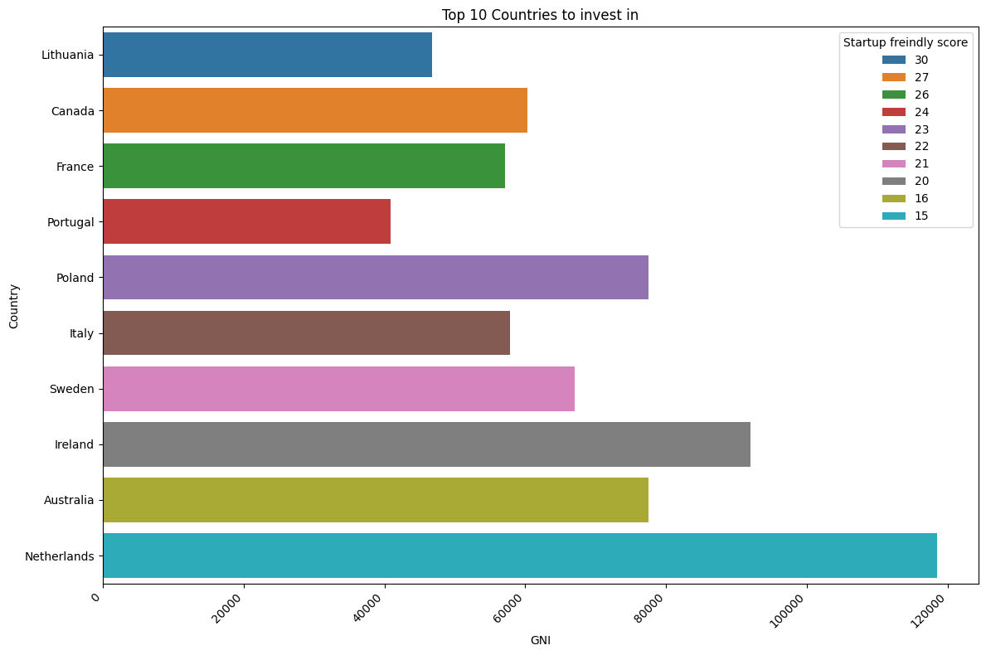
NET WORTH
Top Countries for Investment
Based on the graph it was observed that:
Startup Friendly Score: Lithuania has the highest score at 30, followed by Canada at 27 and France at 26.
GNI: Netherlands has the highest GNI, followed by Ireland, Poland and Australia, however, all of them rank low in Startup Friendly Score except for Poland
So, the most guaranteed countries are Lithuania, Canada, France, Portugal and Poland

Slide 16

NET WORTH
Final Decision for Investment
Studying all of the previous insights, the countries chosen for investment are:
Lithuania
Canada
France
Portugal
Poland
The selected industries are:
Technology
Fashion & Retail
Finance & Investments
Healthcare:

Slide 17
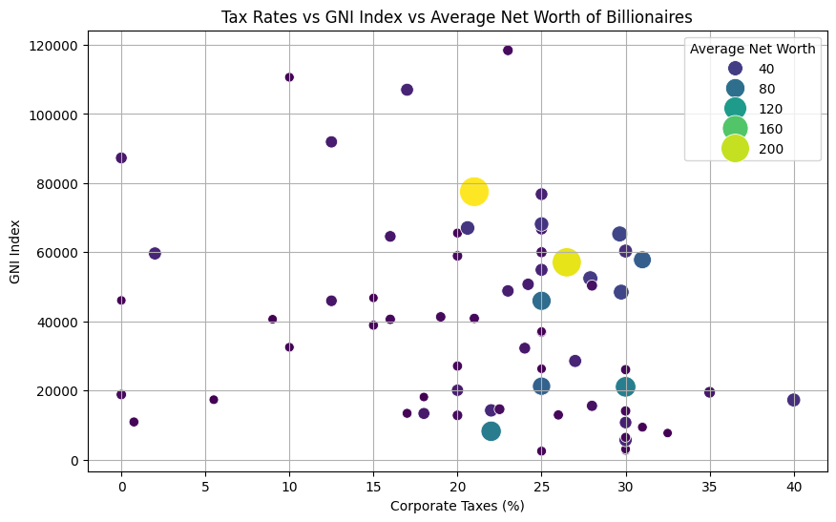
NET WORTH
Taxes and Net Worth
The CEOs even studied if the countries they work and invest in would affect their net worth in a negative way given their high taxes.
However, the graph shows that:
The average net worths actually exits in the countries with higher taxes rate which did not hinder the progress of any business there.

Slide 18

CONCLUSION
Final Words
The journey through "Exploring the Evolution of Billionaires: A Data-Driven Analysis over the last two decades" has been both enlightening and impactful.
This comprehensive analysis has not only deepened the CEO’s understanding of how billionaires accumulate wealth but also provided valuable insights into the dynamics that influence this accumulation over time.
Finally, they served the community by laying down their road-map to become self-made billionaires

Slide 19
ThankYou
ANY QUESTIONS?

